Slide 1
UFCFB6-30-2 Object-oriented Software Development
Unit 12 Advanced Concurrency and Java Threads
Benedict R. Gaster
2016-17

Slide 2
Outline
Problem and solution with threads
Simple synchronized method/statement
Atomic actions: volatile variables
Atomic variables
Deadlock
Guarded conditions: wait, notifyAll, notify

Slide 3
An example that may cause data corruption
The Account class is a bank account, contains methods such as deposit and withdraw.
Cardholder is a thread allows the card holder to deposit £10 repeatedly for 5 times.
FamilyAccount has a main methods that creates one instance of an Account, two instances of Cardholders, both putting money into the same account.

Slide 4
An example that may cause data corruption – Account class
class Account {
private int balance=0;
public void deposite(int a, String name) {
int tmp = balance;
System.out.println(name+": tmp(current balance)="+tmp);
balance = tmp + a;
System.out.println(name +" balance is " + balance);
}
}

Slide 5
An example that may cause data corruption – CardHolder thread class
public class CardHolder implements Runnable{
private String name;
private Account acc;
CardHolder(Account acc,String n){
name=n;
this.acc=acc;
}
public void run(){
for (int i = 0; i < 5; i++) {
acc.deposite(10, name);
}
}
}

Slide 6
An example that may cause data corruption – the main method
class FamilyAccount {
public static void main(String [] args) {
Account ourAccount=new Account();
CardHolder c1 = new CardHolder(ourAccount,“John");
CardHolder c2 = new CardHolder(ourAccount,"Kate");
(new Thread(c1)).start();
(new Thread(c2)).start();
}
}//FamilyAccount

Slide 7
Expected behaviour
c1
c2
deposit(10)
deposit(10)
deposit(10)
deposit(10)
deposit(10)
deposit(10)
deposit(10)
deposit(10)
deposit(10)
deposit(10)

Slide 8
Expected output from FamilyAccount
The result should be:
John: tmp(current balance)=0
John balance is 10
Kate: tmp(current balance)=10
Kate balance is 20
……
John: tmp(current balance)=70
John balance is 80
Kate: tmp(current balance)=80
Kate balance is 90
John: tmp(current balance)=90
John balance is 100
But a shared resource, i.e. the balance in the Account, may be corrupted if it is accessed simultaneously by multiple threads
Notes:
Run FamilyAccount in the E:clientserver/threads (account,cardholder,familyAccount)

Slide 9
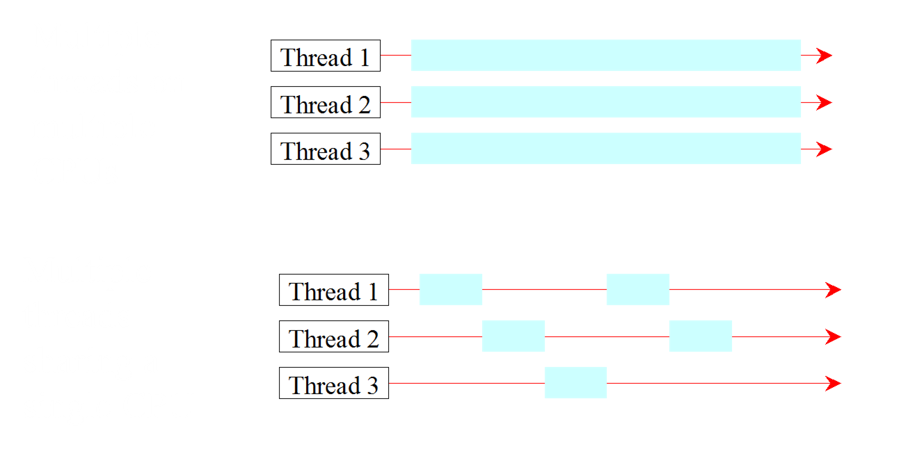
Threads sharing a single CPU
Multiple threads on multiple CPUs
Multiple threads sharing a single CPU

Slide 10
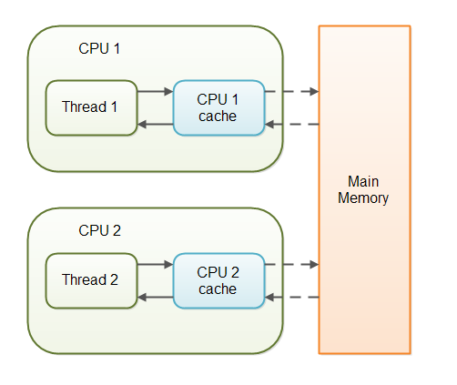
Threads different CPUs with their caches
Notes:
In a multithreaded application where the threads operate on non-volatile variables, each thread may copy variables from main memory into a CPU cache while working on them, for performance reasons. If your computer contains more than one CPU, each thread may run on a different CPU. That means, that each thread may copy the variables into the CPU cache of different CPUs. This diagram illustrates such a situation:

Slide 11
Problem scenario
Assuming current balance in ourAccount is £50,
The c1 thread: tries to deposit £10;
c1.tmp =50 ;The thread is suspended;
The c2 thread: tries to deposit £10;
c2.tmp=50; The thread is then suspended;
c1 resumes:
balance=c1.tmp+10; (50+10=60); c1 is suspended
c2 resumes:
balance=c.tmp+10; (tmp=50) i.e. balance=60
Should be 70, not 60!
balance=50
balance=50
balance=50
balance=tmp+10
balance=60
balance=tmp+10
balance=60
Notes:
Mention timeslices. Threads in a queue, Scheduler takes out one thread, let it execute af ew steps and move ontot he next thread.

Slide 12
An example that may cause data corruption – Account class
class Account {
private int balance=0;
public void deposite(int a, String name) {
int tmp = balance;
System.out.println(name+": tmp(current balance)="+tmp);
balance = tmp + a;
System.out.println(name +" balance is " + balance);
}
}

Slide 13
Possible output from the FamilyAccount program:
Kate: tmp(current balance)=0
John: tmp(current balance)=0
Kate balance is 10
John balance is 10
…..
John: tmp(current balance)=20
Kate: tmp(current balance)=20
Kate balance is 30
Kate: tmp(current balance)=30
John balance is 30
John: tmp(current balance)=30
John balance is 40
John: tmp(current balance)=40
Kate balance is 40
Kate: tmp(current balance)=40
Kate balance is 50
John balance is 50
The final balance should be 100!

Slide 14
Thread Synchronization
A shared resource may be corrupted if it is accessed simultaneously by multiple threads. For example, two unsynchronized threads accessing the same bank account may cause conflict.

Slide 15
Critical Region and Race condition
The problem is that the two threads (c1 john and c2 kate) are accessing the same resource (account) in a way that causes a conflict.
This is a common problem, known as a race condition, in multithreaded programs.
The block of code that accesses and updates the shared data is a critical region.
A class is said to be thread-safe if an object of the class does not cause a race condition in the presence of multiple threads.
The Account class is not thread-safe at the moment.
Notes:
A race condition occurs when two or more threads can access shared data and they try to change it at the same time. Because the thread scheduling algorithm can swap between threads at any time, you don't know the order in which the threads will attempt to access the shared data. Therefore, the result of the change in data is dependent on the thread scheduling algorithm, i.e. both threads are "racing" to access/change the data.
Problems often occur when one thread does a "check-then-act" (e.g. "check" if the value is X, then "act" to do something that depends on the value being X) and another thread does something to the value in between the "check" and the "act". E.g:
if (x == 5) // The "Check" { y = x * 2; // The "Act" // If another thread changed x in between "if (x == 5)" and "y = x * 2" above, // y will not be equal to 10. } The point being, y could be 10, or it could be anything, depending on whether another thread changed x in between the check and act. You have no real way of knowing.
In order to prevent race conditions from occurring, you would typically put a lock around the shared data to ensure only one thread can access the data at a time. This would mean something like this:
// Obtain lock for x if (x == 5) { y = x * 2; // Now, nothing can change x until the lock is released. // Therefore y = 10 } // release lock for x

Slide 16
Protecting shared data using synchronized method
There is a need to protect the shared data by ensuring that only one thread can access the critical region.
Use synchronized methods so that there can be only one thread executing this method at a time.
Java guarantees once a thread has gained access to a synchronized method, it will finish the method before any other thread gains access to that or any other synchronized method in that object.
A synchronised method (implicitly) acquires a lock on the instance.

Slide 17
Deposit as a Synchronized method
public class Account {
private int balance;
Account(int a) {
balance = a;
}
public synchronized void deposite(int a, String name) {
int tmp = balance;
System.out.println(name+": tmp(current balance)="+tmp);
balance = tmp + a;
System.out.println(name + " balance is " + balance);
}
}
Notes:
Run the program familyAccount, change the first line of deposit

Slide 18
synchronized method in Account
To avoid race conditions, more than one thread must be prevented from simultaneously entering certain part of the program, known as critical region.
The critical region in the example is the entire deposit method.
You can use the synchronized keyword to synchronize the method so that only one thread can access the method at a time.

Slide 19
Synchronizing Instance Methods and Static Methods (skip)
A synchronized method acquires a lock before it executes.
In the case of an instance method, the lock is on the object for which the method was invoked.
In the case of a static method, the lock is on the class.
If one thread invokes a synchronized instance method (respectively, static method) on an object, the lock of that object (respectively, class) is acquired first, then the method is executed, and finally the lock is released. Another thread invoking the same method of that object (respectively, class) is blocked until the lock is released.

Slide 20
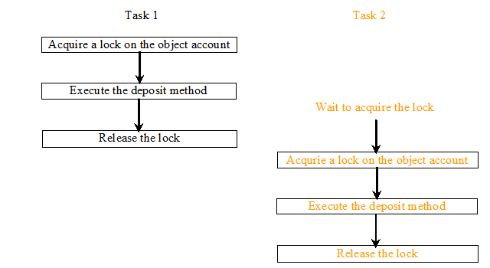
Synchronizing Methods
With the deposit method synchronized, the preceding scenario cannot happen. If Task 2 (c2) starts to enter the method, and Task 1 is already in the method, Task 2 (c2) is blocked until Task 1 (c1) finishes the method.

Slide 21
Possible output from FamilyAccount (with synchronized method)
John: tmp(current balance)=0
John balance is 10
Kate: tmp(current balance)=10
Kate balance is 20
Kate: tmp(current balance)=20
Kate balance is 30
John: tmp(current balance)=30
John balance is 40
John: tmp(current balance)=40
John balance is 50
John: tmp(current balance)=50
John balance is 60
Kate: tmp(current balance)=60
Kate balance is 70
Kate: tmp(current balance)=70
Kate balance is 80
Kate: tmp(current balance)=80
Kate balance is 90
John: tmp(current balance)=90
John balance is 100

Slide 22
Synchronizing Statements
Synchronized statements are also useful for improving concurrency with fine-grained synchronization.
A synchronized statement can be used to acquire a lock on any object, not just this object, when executing a block of code in a method. This block is referred to as a synchronized block. The general form of a synchronized statement is as follows:
synchronized (expr) {
statements;
}
The expression expr must evaluate to an object reference. If the object is already locked by another thread, the thread is blocked until the lock is released. When a lock is obtained on the object, the statements in the synchronized block are executed, and then the lock is released.
Notes:
Synchronized statements are also useful for improving concurrency with fine-grained synchronization. Suppose, for example, class MsLunch has two instance fields, c1 and c2, that are never used together. All updates of these fields must be synchronized, but there's no reason to prevent an update of c1 from being interleaved with an update of c2 — and doing so reduces concurrency by creating unnecessary blocking. Instead of using synchronized methods or otherwise using the lock associated with this, we create two objects solely to provide locks.
public class MsLunch { private long c1 = 0; private long c2 = 0; private Object lock1 = new Object(); private Object lock2 = new Object(); public void inc1() { synchronized(lock1) { c1++; } } public void inc2() { synchronized(lock2) { c2++; } } }

Slide 23
Synchronizing Statements vs. Methods
Any synchronized instance method can be converted into a synchronized statement. Suppose that the following is a synchronized instance method:
public synchronized void xMethod() {
// method body
}
This method is equivalent to
public void xMethod() {
synchronized (this) {
// method body
}
}

Slide 24
Synchronized statements
Synchronized statements are useful for improving concurrency with fine-grained synchronization.
for example, class MsLunch has two instance fields, c1 and c2, that are never used together. All updates of these fields must be synchronized, but there's no reason to prevent an update of c1 from being interleaved with an update of c2 — and doing so reduces concurrency by creating unnecessary blocking. Instead of using synchronized methods or otherwise using the lock associated with this, we create two objects solely to provide locks.
public class MsLunch {
private long c1 = 0;
private long c2 = 0;
private Object lock1 = new Object();
private Object lock2 = new Object();
public void inc1() { … synchronized(lock1) { c1++; } … }
public void inc2() { … synchronized(lock2) { c2++; } … }
}
Notes:
Use this idiom with extreme care. You must be absolutely sure that it really is safe to interleave access of the affected fields.

Slide 25
Volatile Variables
Volatile variables are a simpler -- but weaker -- form of synchronization than locking, which in some cases offers better performance or scalability than intrinsic locking.
Volatile keyword in Java is used as an indicator to Java compiler and Thread that do not cache value of this variable and always read it from main memory.
Volatile variables share the visibility features of synchronized, but none of the atomicity features. This means that all reader thread will see updated value of volatile variable once write operation completed, without volatile keyword different reader thread may see different values.
Conditions for correct use of volatile
Writes to the variable do not depend on its current value.
The variable does not depends on other variables.
Notes:
Locks offer two primary features: mutual exclusion and visibility. Mutual exclusion means that only one thread at a time may hold a given lock, and this property can be used to implement protocols for coordinating access to shared data such that only one thread at a time will be using the shared data. Visibility is more subtle and has to do with ensuring that changes made to shared data prior to releasing a lock are made visible to another thread that subsequently acquires that lock -- without the visibility guarantees provided by synchronization, threads could see stale or inconsistent values for shared variables, which could cause a host of serious problems.
CPUs don't always write data to memory in the order it was updated.
Thread visibility problems may occur in a code that isn't properly synchronized according to the java memory model. Due to compiler & hardware optimizations, writes by one thread aren't always visible by reads of another thread. The Java Memory Model is a formal model that makes the rules of "properly synchronized" clear, so that programmers can avoid thread visibility problems.
use of volatile keyword also prevents compiler or JVM from reordering of code Happens-before is a relation defined in that model, and it refers to specific executions. A write W that is proven to be happens-before a read R is guaranteed to be visible by that read, assuming that there's no other interfering write (i.e. one with no happens-before relation with the read, or one happening between them according to that relation).

Slide 26
Atomic Variables
The java.util.concurrent.atomic package defines classes that support atomic operations on single variables.
All classes have get and set methods that work like reads and writes on volatile variables. That is, a set has a happens-before relationship with any subsequent get on the same variable. The atomic compareAndSet method also has these memory consistency features, as do the simple atomic arithmetic methods that apply to integer atomic variables.
import java.util.concurrent.atomic.AtomicInteger;
class AtomicCounter {
private AtomicInteger c = new AtomicInteger(0);
public void increment() {
c.incrementAndGet();
}
public void decrement() {
c.decrementAndGet();
}
public int value() {
return c.get();
}
}
Notes:
To see how this package might be used, let's return to the Counter class we originally used to demonstrate thread interference:
class Counter { private int c = 0; public void increment() { c++; } public void decrement() { c--; } public int value() { return c; } }
One way to make Counter safe from thread interference is to make its methods synchronized, as in SynchronizedCounter:
class SynchronizedCounter { private int c = 0; public synchronized void increment() { c++; } public synchronized void decrement() { c--; } public synchronized int value() { return c; } }
For this simple class, synchronization is an acceptable solution. But for a more complicated class, we might want to avoid the liveness impact of unnecessary synchronization. Replacing the int field with an AtomicInteger allows us to prevent thread interference without resorting to synchronization, as inAtomicCounter:
import java.util.concurrent.atomic.AtomicInteger; class AtomicCounter { private AtomicInteger c = new AtomicInteger(0); public void increment() { c.incrementAndGet(); } public void decrement() { c.decrementAndGet(); } public int value() { return c.get(); } }

Slide 27
Deadlock
Deadlock describes a situation where two or more threads are blocked forever, waiting for each other..
Alphonse and Gaston are friends, and great believers in courtesy. A strict rule of courtesy is that when you bow to a friend, you must remain bowed until your friend has a chance to return the bow. Unfortunately, this rule does not account for the possibility that two friends might bow to each other at the same time.

Slide 28
Friend class
class Friend {
private final String name;
public Friend(String name) {
this.name = name;
}
public String getName() {
return this.name;
}
public synchronized void bow(Friend bower) {
System.out.println(name + ": " + name + " bows to " + bower.getName());
System.out.println(name + " waits for "+ bower.getName() +" to bow back");
bower.bowBack(this);
}
public synchronized void bowBack(Friend bower) {
System.out.println(name + ": " + name + " bows back to" +bower.getName());
}
}
Notes:
The deadlock is occurring because the following method calls occur:
Alphonse calls bow(), getting Alphonse/bow lock
Gaston calls bow(), getting Gaston/bow lock
Alphonse tells Gaston to bowBack(), and waits for Gaston to complete that action
Gaston tells Alphonse to bowBack(), and waits for Alphonse to complete that action.
thus, both are waiting for the other to finish bowBack() in order to finish their bow(), but cannot start their own bowBack() until they finish bow(). Deadlock.
The reason your solution works is that the bowBack(this) call is outside of the synchronized block.
Smart use of Locks can both demonstrate more clearly why and exactly where deadlock is occurring, and can prevent it. Java's Semaphore class is a nice one to look into.
To actually fix it (prevent deadlock but keep it thread safe), you have to expand on the problem - what should happen when Gaston is waiting for Alphonse to finish bow() to execute his own bow(), but Alphonse needs Gason to execute a bowBack() to finish? One sensible solution is for Gaston to give up on executing bow() when the call to bowBack() comes and just execute bowBack(), but it all depends on what problem you're trying to solve.
Think about how to solve this problem.

Slide 29
ShowDeadlock Class
public static void main(String[] args) {
final Friend alphonse = new Friend("Alphonse");
final Friend gaston = new Friend("Gaston");
new Thread(new Runnable() {
public void run() {
alphonse.bow(gaston);
}
}).start();
new Thread(new Runnable() {
public void run() {
gaston.bow(alphonse);
}
}).start();
}
Notes:
Example code in codeSoFar/AdditionalCOde/AdvancedThread

Slide 30
Deadlock output
Alphonse: Alphonse bows to Gaston
Alphonse waits for Gaston to bow back
Gaston: Gaston bows to Alphonse
Gaston waits for Alphonse to bow back
Cannot carry on …

Slide 31
Guarded Blocks
Threads often have to coordinate their actions. The most common coordination idiom is the guarded block. Such a block begins by polling a condition that must be true before the block can proceed. There are a number of steps to follow in order to do this correctly.
Let's use guarded blocks to create a Producer-Consumer application. This kind of application shares data between two threads: the producer, that creates the data, and the consumer, that does something with it. The two threads communicate using a shared object. Coordination is essential: the consumer thread must not attempt to retrieve the data before the producer thread has delivered it, and the producer thread must not attempt to deliver new data if the consumer hasn't retrieved the old data.
Notes:
There are a few things to note about the way in which you must use the wait and notify mechanisms.
Firstly, you need to ensure that any calls to wait() or notify() are within a synchronized region of code (with the wait() and notify() calls being synchronized on the same object). The reason for this (other than the standard thread safety concerns) is due to something known as a missed signal.
An example of this, is that a thread may call put() when the queue happens to be full, it then checks the condition, sees that the queue is full, however before it can block another thread is scheduled. This second thread then take()'s an element from the queue, and notifies the waiting threads that the queue is no longer full. Because the first thread has already checked the condition however, it will simply call wait()after being re-scheduled, even though it could make progress.
By synchronizing on a shared object, you can ensure that this problem does not occur, as the second thread's take() call will not be able to make progress until the first thread has actually blocked.
Secondly, you need to put the condition you are checking in a while loop, rather than an if statement, due to a problem known as spurious wake-ups. This is where a waiting thread can sometimes be re-activated without notify() being called. Putting this check in a while loop will ensure that if a spurious wake-up occurs, the condition will be re-checked, and the thread will call wait() again.

Slide 32
Drop (or buffer)
public class Drop {
private String message;
private boolean empty = true;
public synchronized String take() {
// Wait until message is available.
while (empty) {
try {
wait();
} catch (InterruptedException e) {}
}
empty = true;
// Notify producer that status has changed.
notifyAll(); // Notify producer that status has changed.
return message;
}
Notes:
Although the put( ) and get( ) methods on Q are synchronized, nothing stops the producer from overrunning the consumer, nor will anything stop the consumer from consuming the same queue value twice. Thus, you get the erroneous output shown here (the exact output will vary with processor speed and task load):
Put: 1 Got: 1 Got: 1 Got: 1 Got: 1 Got: 1 Put: 2 Put: 3 Put: 4 Put: 5 Put: 6 Put: 7 Got: 7

Slide 33
Drop (or buffer)
public synchronized void put(String message) {
// Wait until message has been taken.
while (!empty) {
try {
wait();
} catch (InterruptedException e) {}
}
// Store message.
this.message = message;
empty = false;
notifyAll(); // Notify consumer that status has changed.
}
}

Slide 34
Producer
public class Producer implements Runnable {
private Drop drop;
Scanner scan=new Scanner(System.in);
public Producer(Drop drop) {
this.drop = drop;
}
public void run() {
while (true) {
String s = scan.nextLine();
drop.put(s);
}
}
}

Slide 35
Consumer
public class Consumer implements Runnable {
private Drop drop;
public Consumer(Drop drop) {
this.drop = drop;
}
public void run() {
while (true) {
String message = drop.take();
System.out.format("MESSAGE RECEIVED: %s%n", message);
}
}
}

Slide 36
Review
Understand the problem and solution with concurrent thread
Simple synchronized method/statement
Volatile variables
Atomic variables
Deadlock
Guarded conditions: wait, notifyAll, notify
Notes:
Java's monitor supports two kinds of thread synchronization: mutual exclusion and cooperation. Mutual exclusion, which is supported in the Java virtual machine via object locks, enables multiple threads to independently work on shared data without interfering with each other. Cooperation, which is supported in the Java virtual machine via the wait and notify methods of class Object, enables threads to work together towards a common goal.
Thread acquires the intrinsic lock when it enters a synchronized method. Thread inside the synchronized method is set as the owner of the lock and is in RUNNABLE state. Any thread that attempts to enter the locked method becomes BLOCKED.
When thread calls wait it releases the current object lock (it keeps all locks from other objects) and than goes to WAITING state.
When some other thread calls notify or notifyAll on that same object the first thread changes state from WAITING to BLOCKED, Notified thread does NOT automatically reacquire the lock or become RUNNABLE, in fact it must fight for the lock with all other blocked threads.
WAITING and BLOCKED states both prevent thread from running, but they are very different.
WAITING threads must be explicitly transformed to BLOCKED threads by a notify from some other thread.
WAITING never goes directly to RUNNABLE.
When RUNNABLE thread releases the lock (by leaving monitor or by waiting) one of BLOCKED threads automatically takes its place.
So to summarize, thread acquires the lock when it enters synchronized method or when it reenters the synchronized method after the wait.
public synchronized guardedJoy() { // must get lock before entering here while(!joy) { try { wait(); // releases lock here // must regain the lock to reentering here } catch (InterruptedException e) {} } System.out.println("Joy and efficiency have been achieved!"); }

